Slide 1
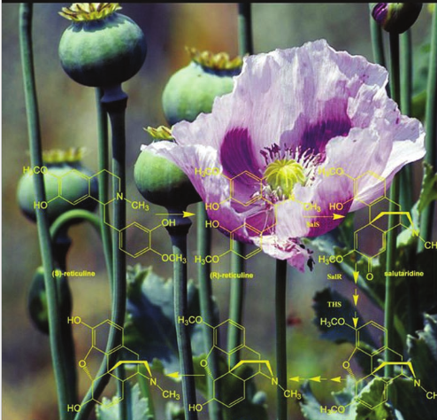
Metabolismo secundario

Slide 2
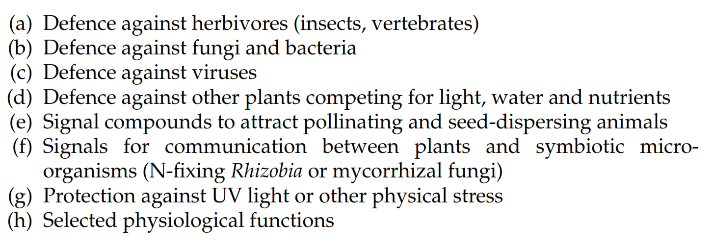
A characteristic feature of plants (and other sessile organisms)
is their capacity to synthesize an enormous variety of low molecular weight compounds,
the so-called secondary metabolites
- Alkaloids, NPAAs, cyanogenic glycosides and protease inhibitors,
are metabolized and serve as a nitrogen source for the growing
seedling

Slide 3
El metabolismo secundario comprende
aquellos procesos químicos y moléculas que no tienen caracter universal,
son únicos para una especie o grupo.
3) cumplen funciones importantes para la supervivencia e interacción con el entorno.
Se los suele clasificar de acuerdo a su origen metabólico
Terpenos (o isoprenoides)
Compuestos fenólicos (o fenilpropanoides)
Compuestos nitrogenados (o alcaloides)

Slide 4
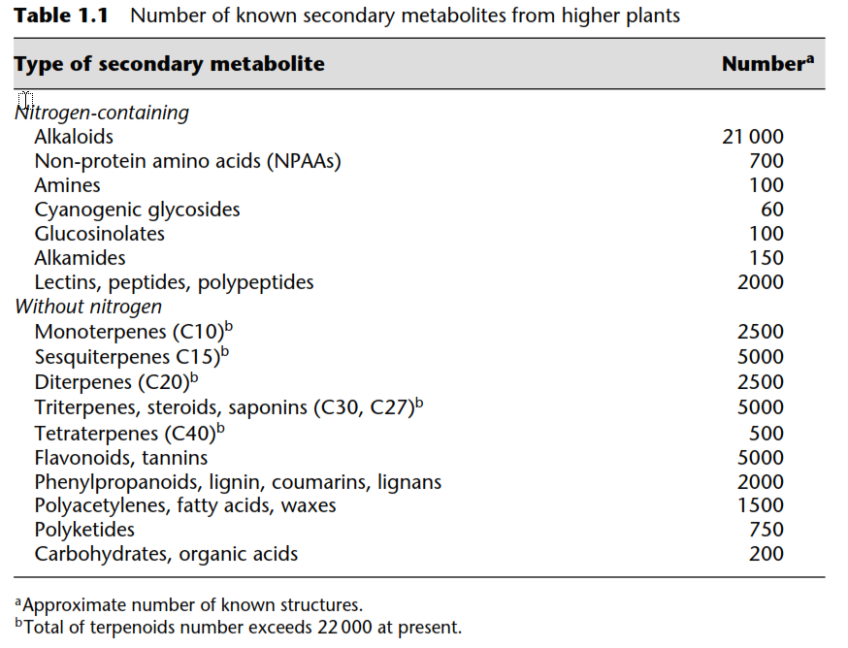
Only 20–30% of higher plants have been investigated so far

Slide 5
Despite the enormous variety of SM, the number of corresponding
basic biosynthetic pathways is restricted and distinct and they have highly speciﬁc biosynthetic enzymes in most instances
Cyanogenic glycosides, glucosinolates, some alkaloids and non-protein amino acids (NPAAs), amines, ﬂavonoids and several terpenes, the enzymes which catalyse individual steps, have been identiﬁed
Isoquinoline, indole, pyrrolidine, pyrrolizidine and tropane alkaloids, ﬂavonoids, coumarins, NPAAs,mono-, sesqui- and triterpenes, some of the genes, which encode biosynthetic enzymes, have already been isolated and characterized
most have been selected towards this special task, although they often derive from common progenitors with
a function in primary metabolism or from prokaryotic
genes imported to plant cells through chloroplasts and mitochondria

Slide 6
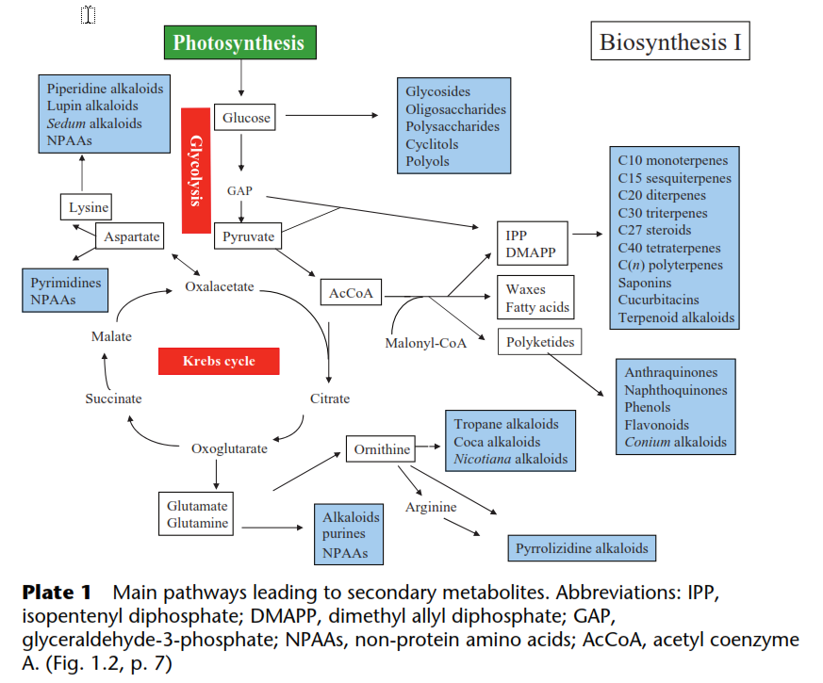

Slide 7
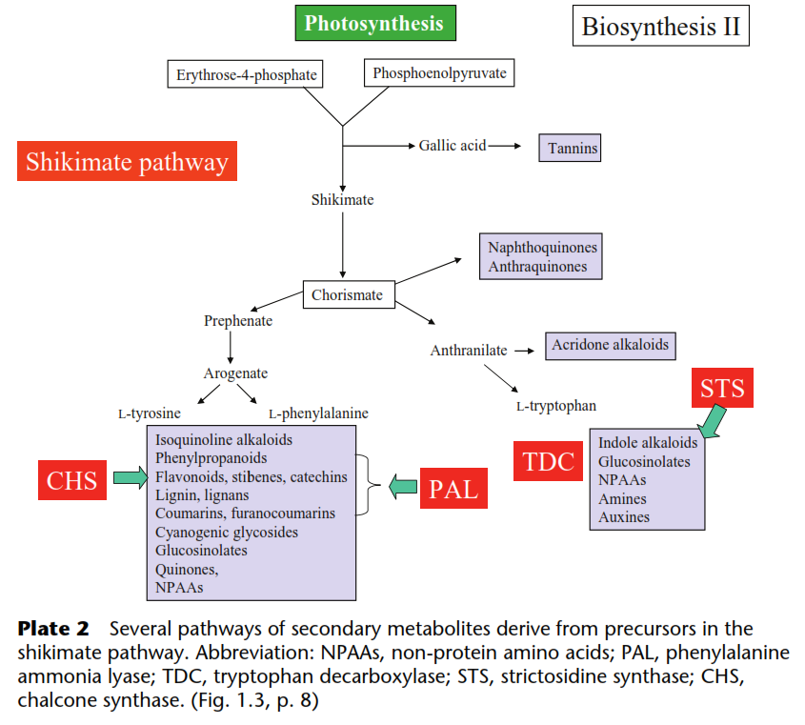

Slide 8
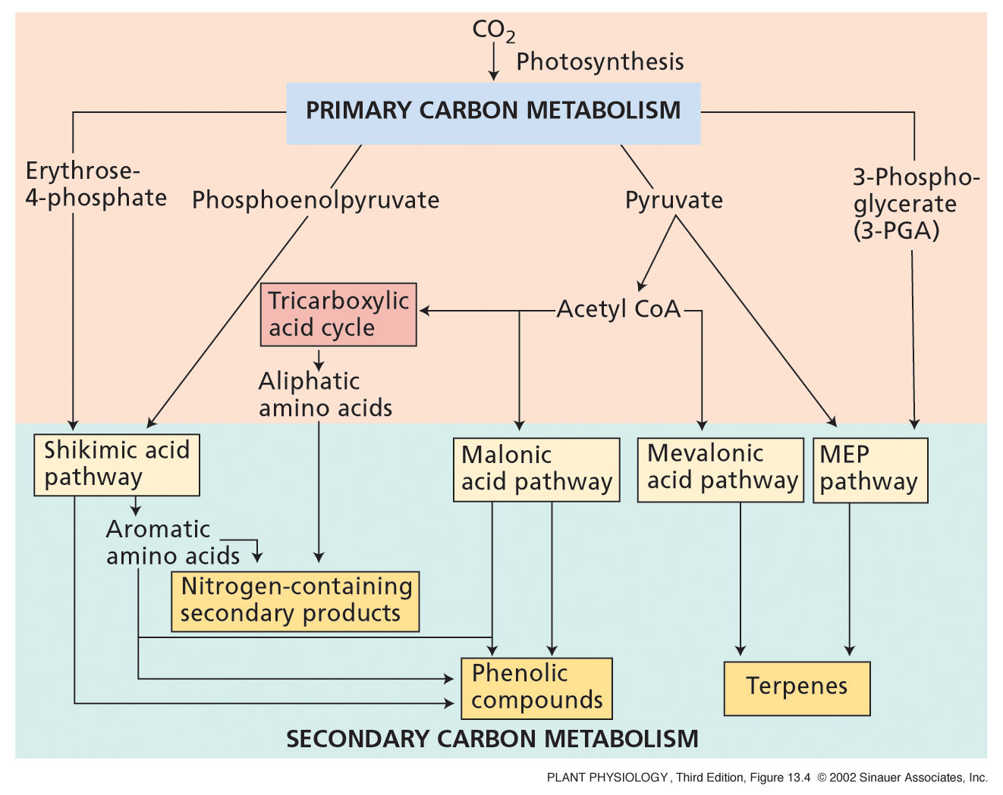
Notes:
PP13040.jpg

Slide 9
Procesos bioquímicos que ocurren en la biosíntesis de Met. Sec.
which directs a certain amount of the primary metabolic flux into secondary metabolism
Branch point enzymes
Compuestos fenólicos
PAL
Alcaloides
derivados de aminoácidos
Descarboxilasas
Terpenos
Sesquiterpen cyclases
Otras enzimas importantes
Oxigenasas
Metyltransferases
Condensacion cola cabeza
Glicosidasas

Slide 10
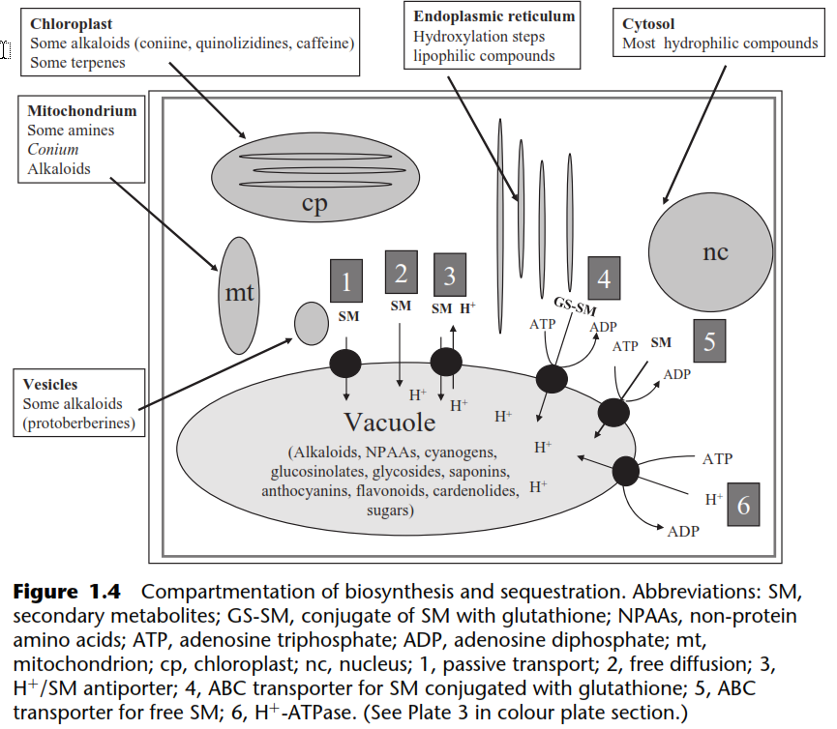
Transport, storage and turnover

Slide 11
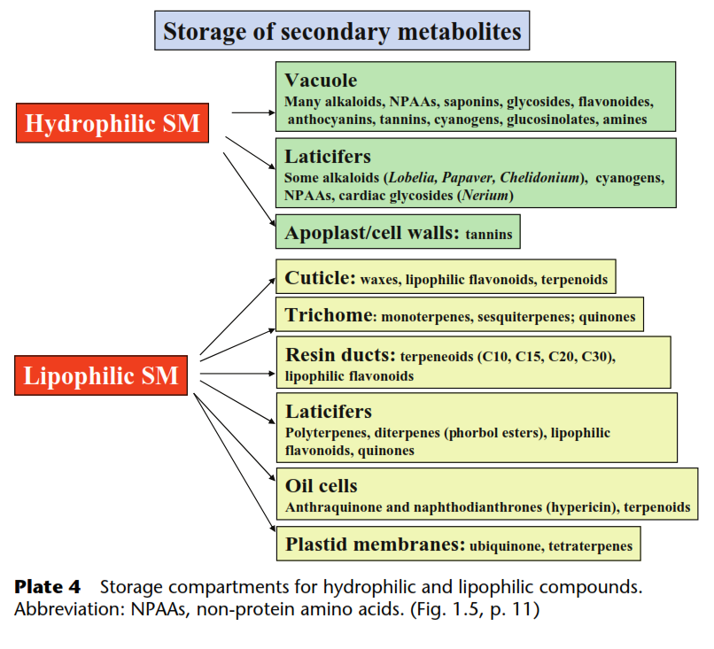
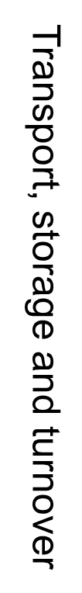

Slide 12
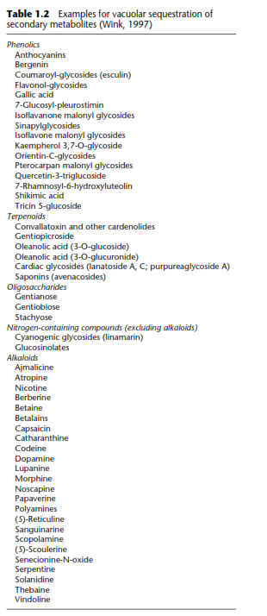

Slide 13
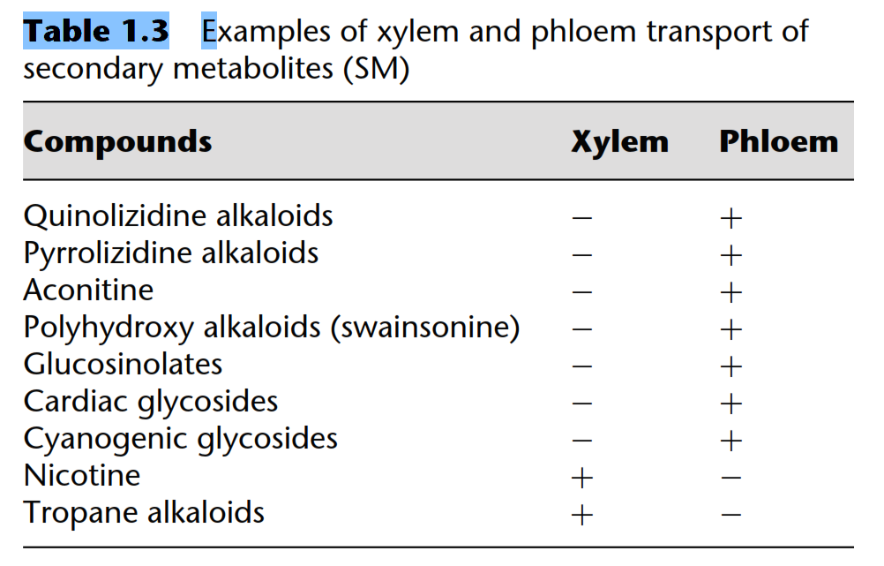

Slide 14
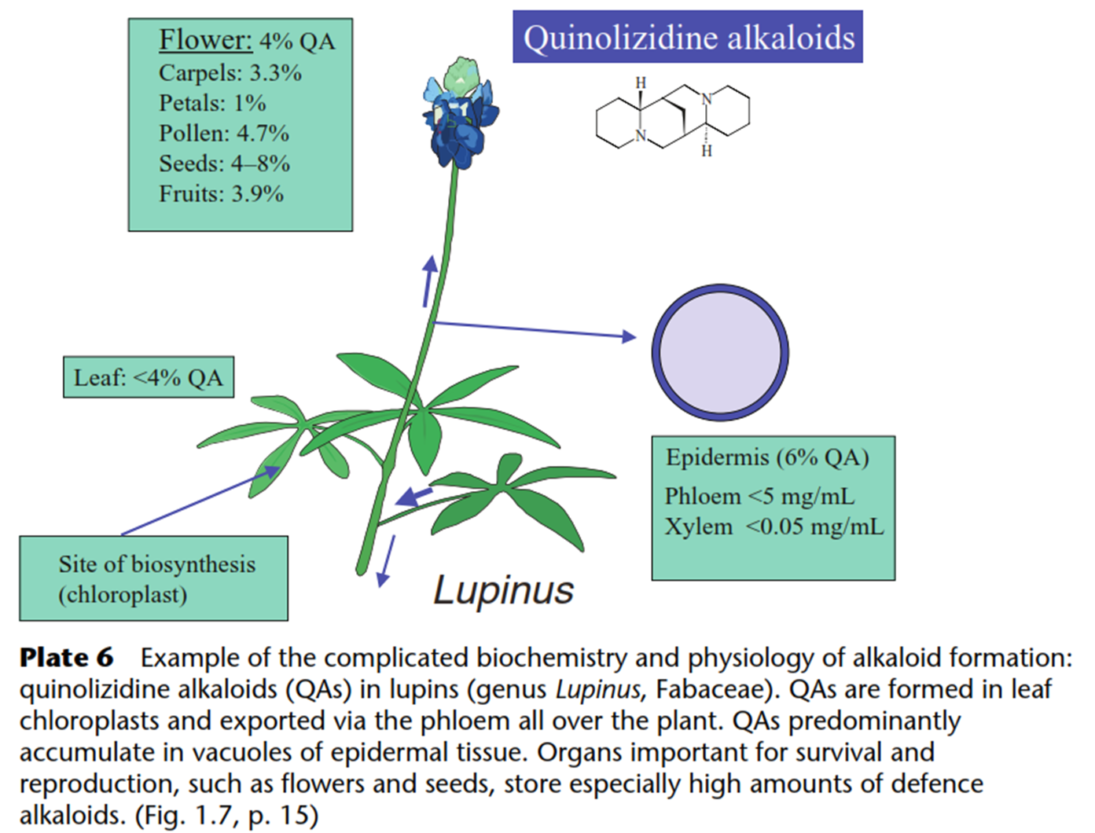


Slide 15
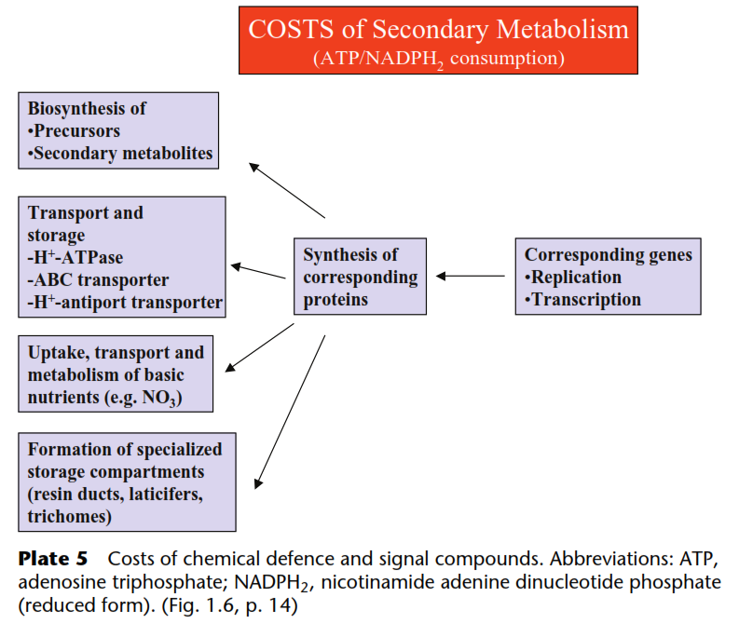

Slide 16
Terpenos
  Han sido descriptas dos vías de síntesis:
  1. Vía citosolica con el ácido mevalónico como precursor
  2. Vía cloroplastica con el metil-eritritol fosfato (MEP) como precursor
  Algunos metabolitos tienen funciones en el metabolismo primario
  Se han descripto mas de 30.000 terpenos
  Filogeneticamente estan ampliamente distribuidos en el reino vegetal, teniendo una importancia clave la duplicacion genética para la aparicion de su diversidad

Slide 17
Notes:
PP13040.jpg

Slide 18
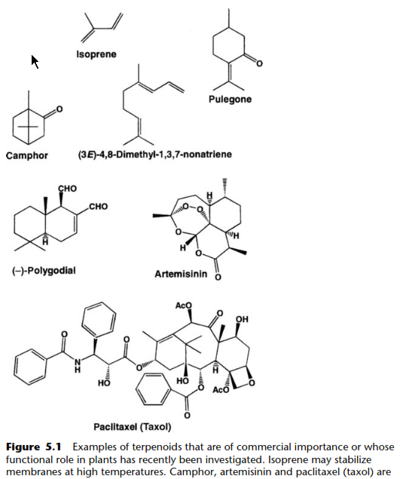
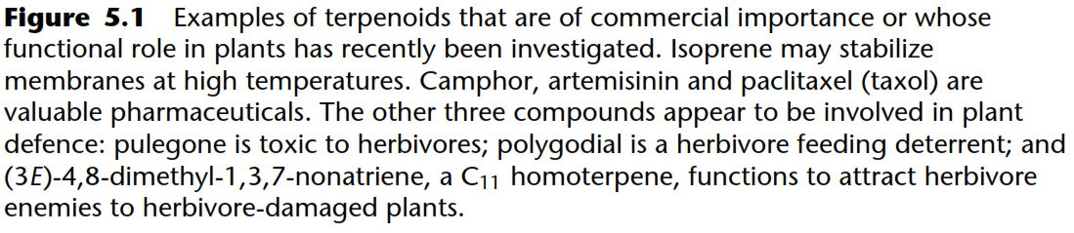

Slide 19

El isopreno es la unidad básica que constituye los terpenos
( terpenos también llamados “isoprenoides”)
It was discovered that some terpenoids could be pyrolized to give isoprene, a C diene with an isopentenoid skeleton

Slide 20
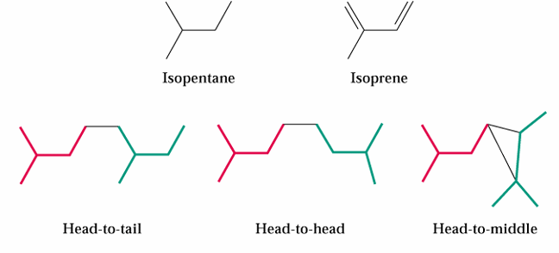
These studies gave rise to the socalled isoprene rule, which states that all terpenoids are derived from the ordered,
head-to-tail joining of isoprene units.
(pyrethrins) which seem to be limited almost exclusively to members of family Asteraceae

Slide 21
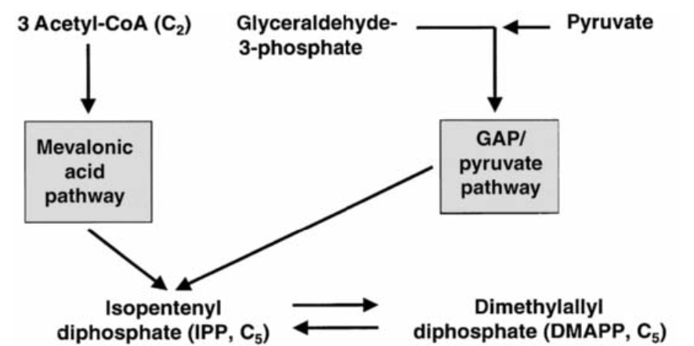
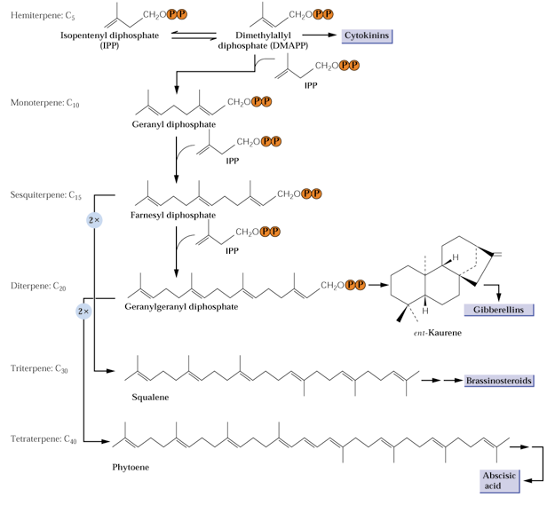

Slide 22
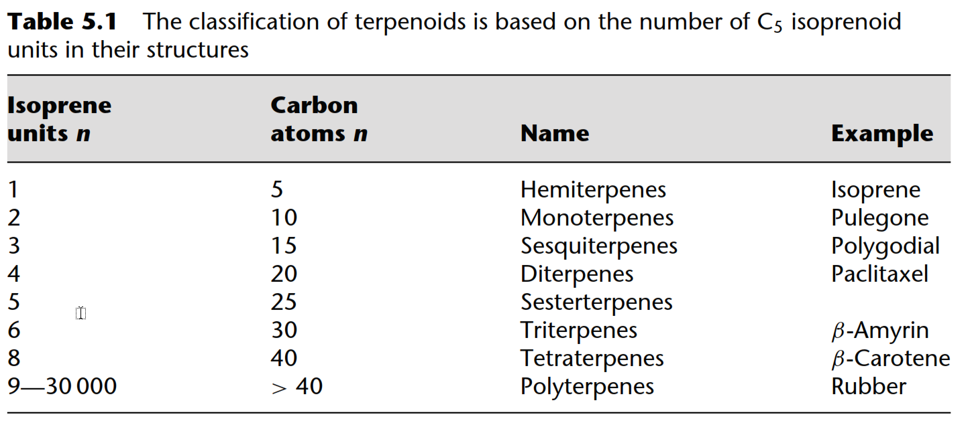
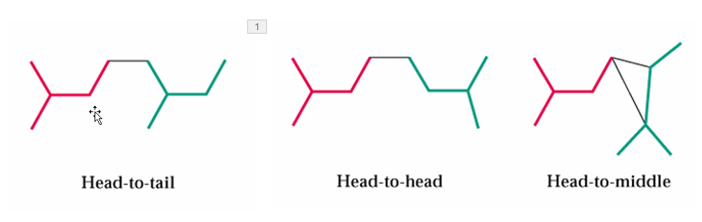

Slide 23
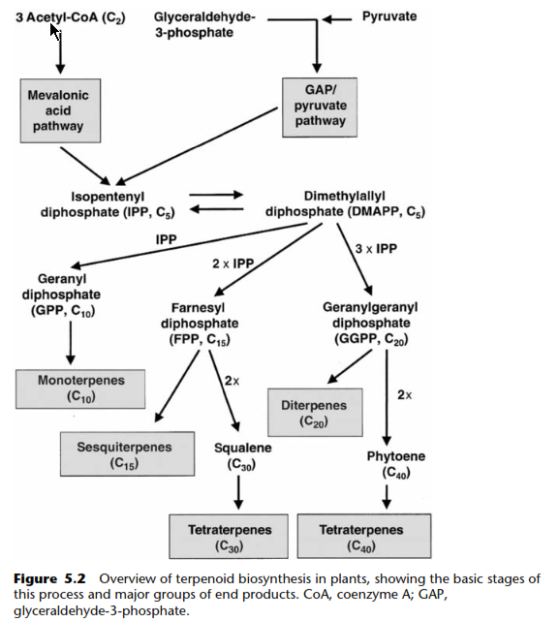
Triterpenos

Slide 24
Building unit of biomolecules, such as hormones, chlorophyll, fragrances, natural rubber
The highest rate of emission in woody plants, e.g. oaks, poplars
Atmospheric chemistry (generate large amounts of O₃, forms secondary organic aerosols
ISOPRENE
Global isoprene emission from plants is
~ 5x10¹⁴ g C year⁻¹
The most common volatile hydrocarbon
Isoprene synthases:
a) thylakoid-bound lumenal protein,
b) free soluble synthase

Slide 25
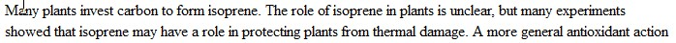
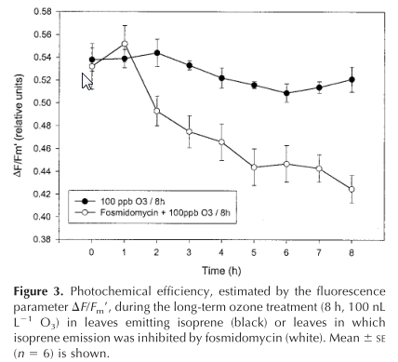
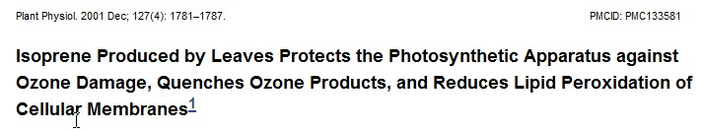

Slide 26
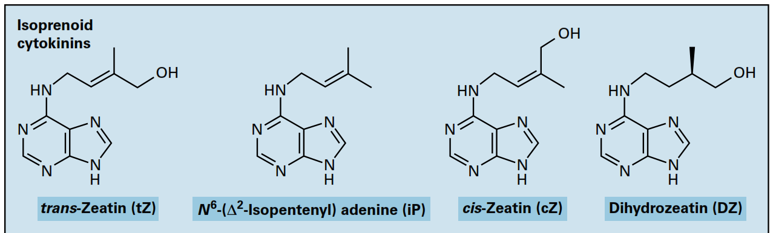

Slide 27
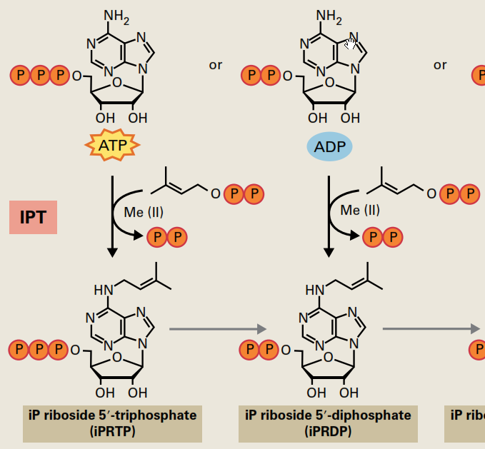
The initial step of isoprenoid CK biosynthesis is catalyzed by adenosine phosphate‐isopentenyltransferase

Slide 28
PRENYLATION
Cytokinins, chlorophylls and the quinone-based electron carriers (the plastoquinones and ubiquinones), have terpenoid side chains attached to a non-terpenoid nucleus.
hydrophobicity
Proteins have also been found to have terpenoid side chains attached.
increases protein hydrophobicity
- facilitate anchoring to or movement within membranes.
- serves to target proteins to membranes or direct protein–protein interactions

Slide 29
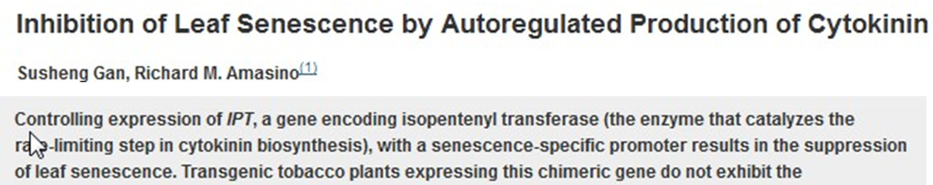
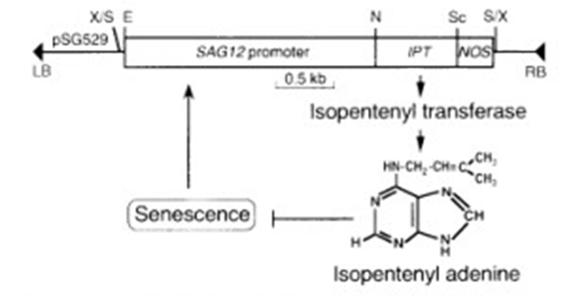
SAG Genes
expresión específica durante el envejeci-miento foliar
Citocinina es una hormona
antisenescente

Slide 30
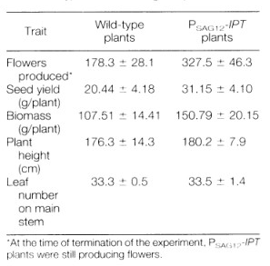

Slide 31
Triterpenos

Slide 33
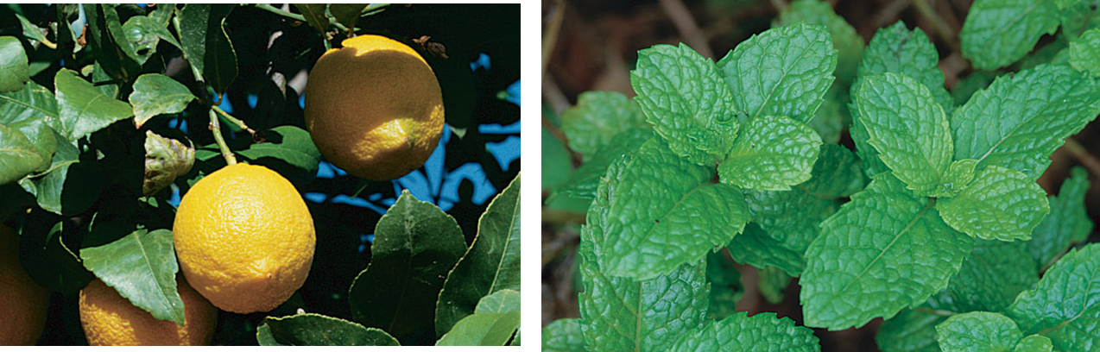
Monoterpenos (C-10)

Slide 34
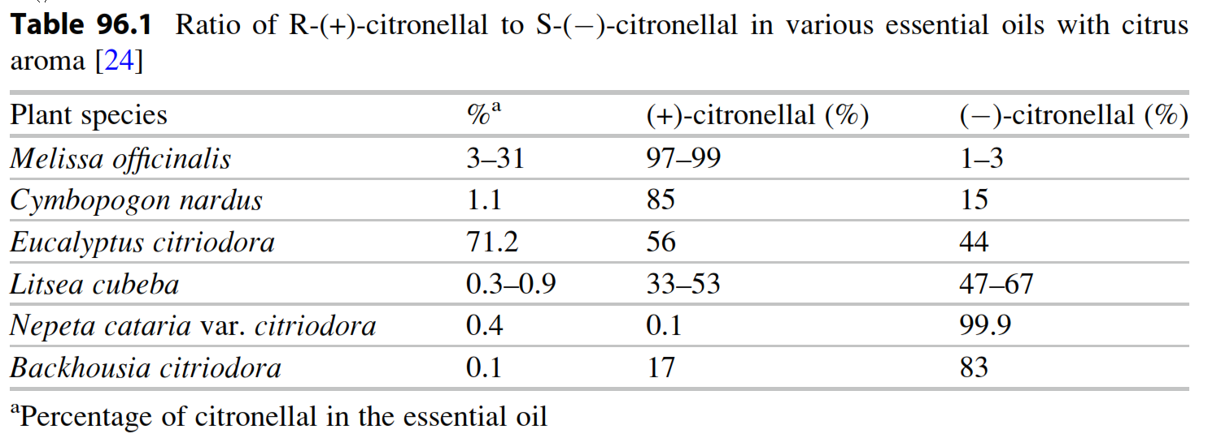

Slide 35
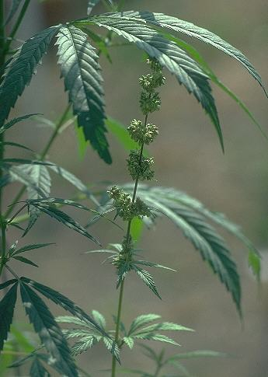
Cannabinoids, from Cannabis sativa (Hemp)

Slide 36


Slide 37
Triterpenos

Slide 38
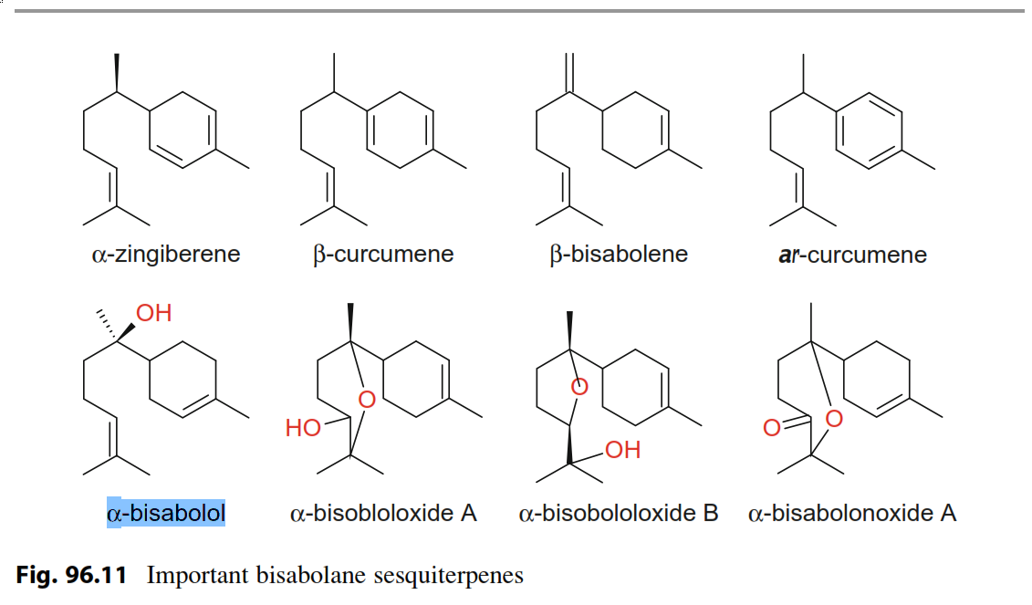
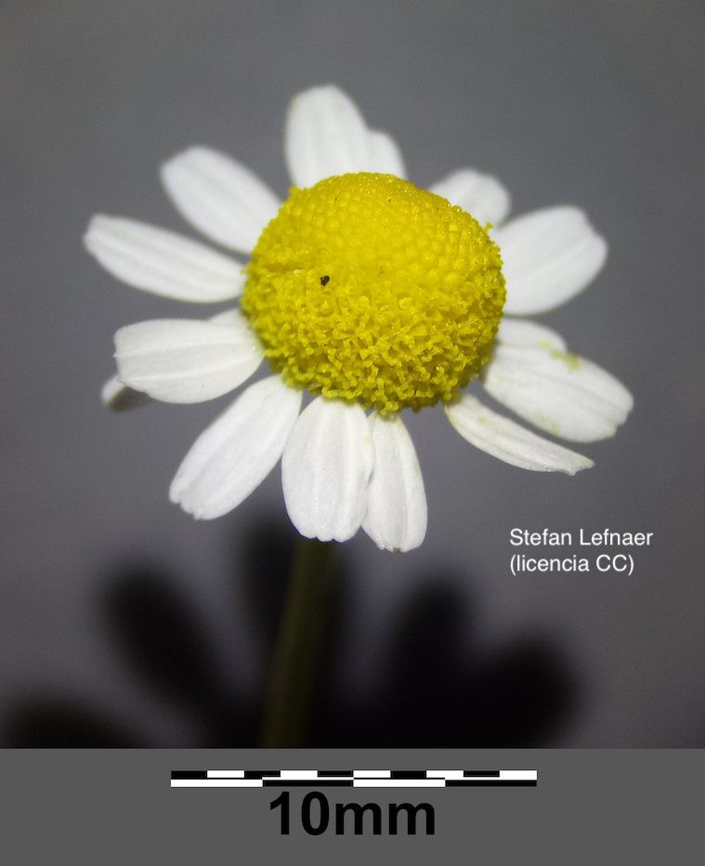
Sesquiterpenos
Guaianolides are a large group of sesquiterpene lactones of chemotaxonomic as well as biological importance.
Thapsigargins isolated from the genus Thapsia(Apiaceae) to inhibit an intracellular calcium pump and therebyinducing apoptosis

Slide 39
Triterpenos

Slide 40
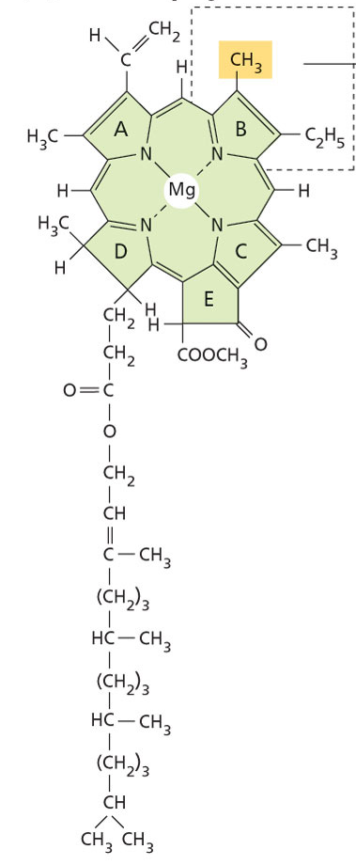
Diterpenes (C-20)

Slide 41
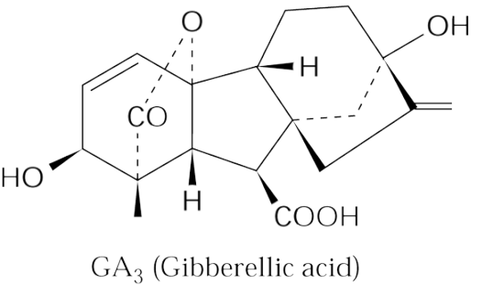
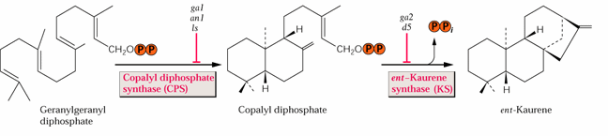
Giberelinas
Sesquiterpen cyclases

Slide 42
Triterpenos

Slide 43
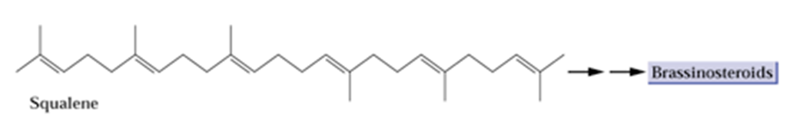
Triterpenes (C-30)
Esteroles

Slide 44
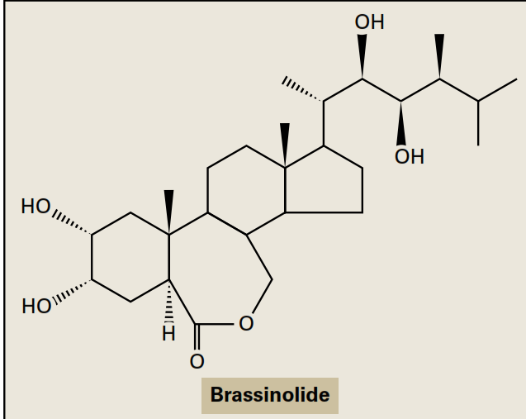
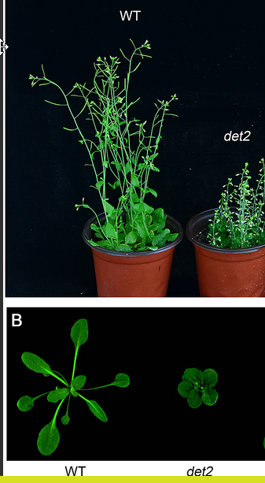

Slide 45
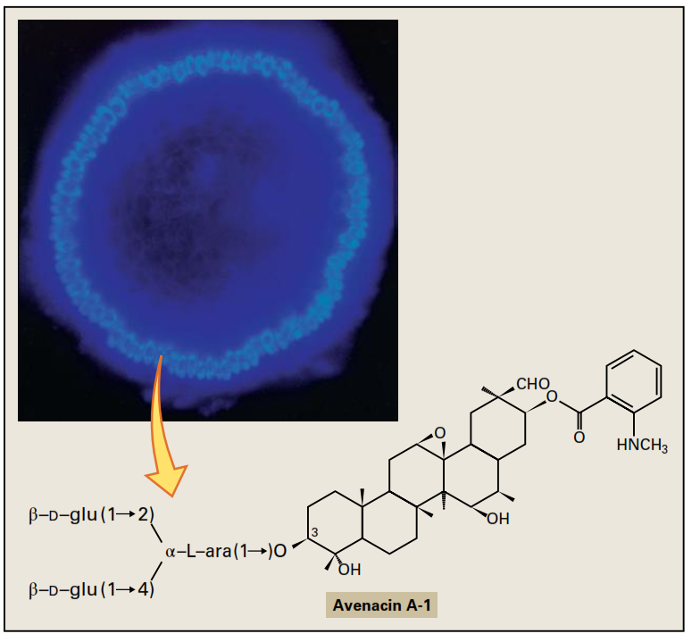
Saponins are glycosylated triterpenoid
Las saponinas son tóxicas, y se cree que su toxicidad proviene de su habilidad para formar complejos con esteroles, por lo que podrían interferir en la asimilación de estos por el sistema digestivo, o romper las membranas de las células tras ser absorbidas hacia la corriente sanguínea.

Slide 46
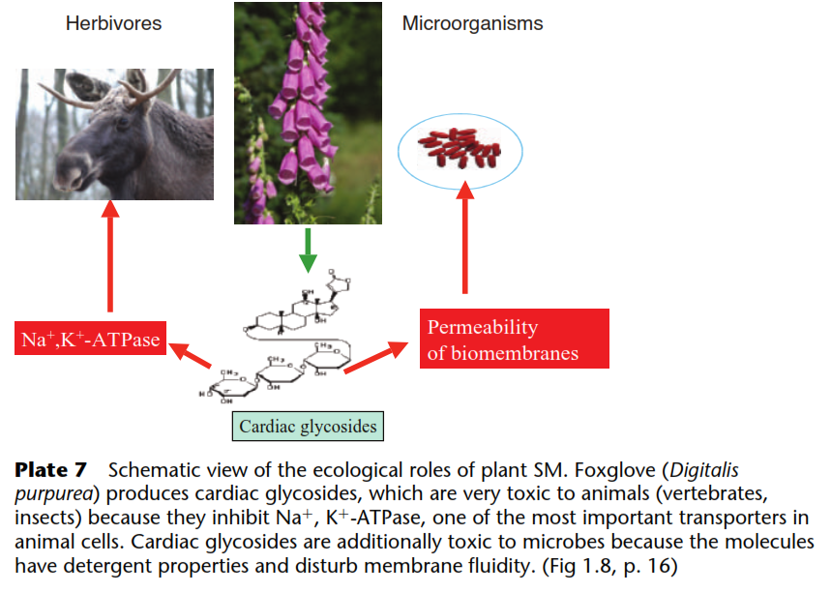
Cardenólidos Digitalis purpurea L. is one of the main sources of cardenolides such as digitoxin and digoxin. These drugs are widely used to strengthen cardiac diffusion and to regulate heart rhythm.

Slide 47
Algunas características sorprendentes de los MS
Multi-target substances
SM often interfere with more than a single molecular target , which is advantageous for the producer, as a toxin might be more efﬁcient if it knocks out two targets instead of one.
Mixtures of several substances,
- mixtures contain substances which might facilitate the uptake of polar SM across biomembranes,for which biomembranes normally constitute a permeation barrier.
ie.; polyphenolics are often accompanied by terpenoids.
As a consequence, it will be more difﬁcult for a herbivore or microbe to develop resistance to such a cocktail, as conco-
mitant resistance at several targets would be required.

Slide 48
Triterpenos

Slide 49
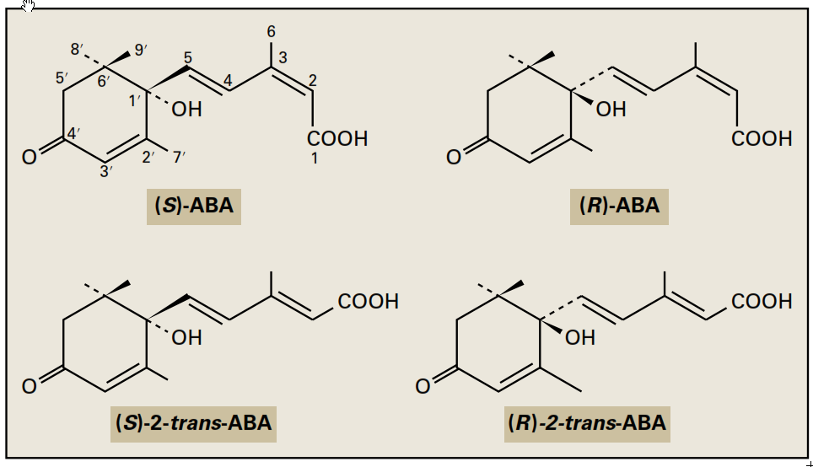
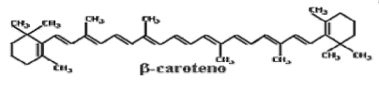
Carotenos

Slide 50
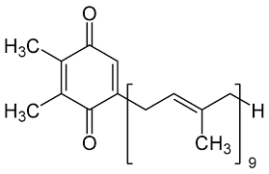
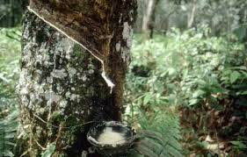
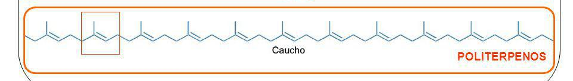

Politerpernos
Plastoquinonas
Gomas
El caucho para neumáticos - un negocio muy rentable | DW Documental

Slide 51
Notes:
PP13040.jpg

Slide 52
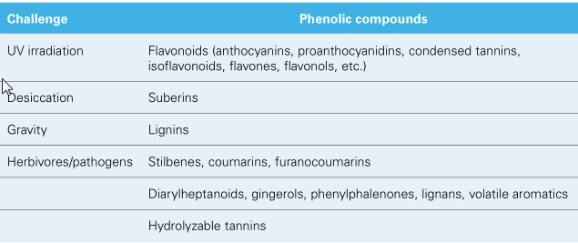
Major subclasses of phenolic compounds include the
- flavonoids,
- anthocyanidins,
- isoflavones,
- chalcones,
- stilbenes,
- coumarins and furanocoumarins,
- monolignols and lignans,
- naptha‐ and anthraquinones,
- and diarylheptanoids.

Slide 53
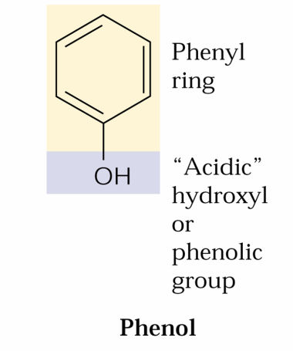
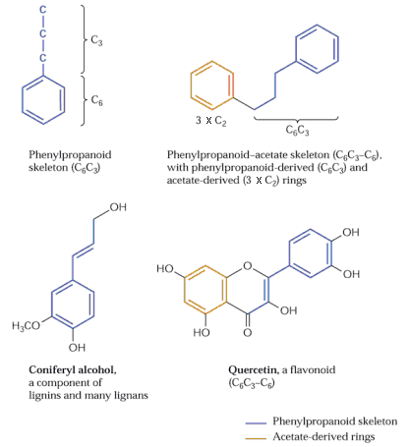
Compuestos fenólicos
o también fenilpropanoides

Slide 54

Simples
Compuestos
Phenolic compounds can be classified in various ways, for example according to the functional groups attached to the phenol, or based on the number of phenol units in the molecule.

Slide 55



Slide 56

Fenoles
Notes:
PP13090.jpg

Slide 57

The shikimic acid pathway is related to the metabolism of carbohydrates and aromatic amino acids.

Slide 58
The shikimic acid pathway is related to the metabolism of carbohydrates and aromatic amino acids.
1) condensation of phosphoenolpyruvate and erythrose-4-phosphate
2) cyclization lead to the formation of shikimic acid and end with the synthesis of chorismic acid
3) Active forms of these with coenzyme A (CoA) can access the main classes of phenolic compounds,
3.1 benzoic acid series (gallic, protocatechuic, etc.) by β-oxidation.
3.2 Gallic acid itself, in combination with simple sugars, leads to the hydrolyzable tannins (gallic and ellagic tannins)
3.3 tyrosine and phenylalanine after the addition of a molecule of phosphoenolpyruvate and additional series of intermediate stages, followed by amination
the starting point of the phenylpropanoid pathway

Slide 59



5-enolpyruvylshikimate-3-phosphate
(EPSP) synthase

Slide 60

General phenylpropanoid pathway
Channelling of the amino acids from primary into secondary metabolism is achieved by the activity of phenylalanine/tyrosine ammonialyases (PAL, TAL)
PAL is inducedby environmental factors,
e.g. pathogen attack or UV light

Slide 61

Biosíntesis de fenoles simples
Notes:
PP13101.jpg

Slide 62


Slide 63

Fenilpropanoides simples
Alelopatía

Slide 64

Fenoles simples
Reguladores del crecimiento vegetal y responsables de la señalización de la respuesta sistémica adquirida)
Compuestos fototóxicos para herbívoros (se insertan en el ADN bloqueando la transcripción)
Notes:
PP13111.jpg

Slide 65
Fenoles
Notes:
PP13090.jpg

Slide 66

Basic structure of phenylpropanoid‐acetate
Notes:
PP13120.jpg

Slide 67


Flavonoides
Products of the phenylpropanoid‐
acetate pathway are called polyketides, and plant polyketide synthases (PKSs) are the
catalysts of polyketide diversity
Notes:
PP13101.jpg

Slide 68


A. thaliana mutants tt4 and tt5 are unable to synthesize a normal complement of flavonoid compounds. tt4 and tt5 are both chalcone synthase mutant while Fahl has a deficiency in activity of ferulic acid hydroxylase

Slide 69


Flavones y flavonoles
El ojo humano percibe un color naranja
El ojo de la abeja percibe una coloración en modelo
Notes:
PP1314A.jpg

Slide 70


Antocianinas
Notes:
PP13130.jpg

Slide 71



Slide 72


Los taninos son conocidos por su capacidad para unirse a hidratos de
carbono y proteínas mediante fuerzas covalentes y no covalentes y por
su astringencia y sabor amargo.
Notes:
PP13151.jpg

Slide 73


Los taninos se unen inespecífica-mente a proteínas del aparato digestivo del depredador inacti-vándolas, incluso de forma irre-versible, si la unión es covalente
Los taninos de alto peso molecular son mejores para precipitar proteínas que los taninos más pequeños.
Ll pH ácido favorece la formación de complejos proteína-tanino, mientras que un pH básico
disminuye considerablemente la formación de puentes de hidrógeno
Notes:
PP13161.jpg

Slide 74
Lignanos
Se encuentran frecuentemente en semillas
Tienen propiedades antioxidantes
Miméticos de hormonas esteroides humanas
(Fitoesteroles)
Posibles anticancerígenos

Slide 75
Compuestos nitrogenados (Alcaloides)
Contienen Nitrogeno y generalmente son alcalinos (alcaloides)
Se conocen mas de 6500 compuestos
Se biosintetizan a partir de aminoácidos
Las vías biosintéticas son escasamente conocidas
Son generalmente altamente tóxicos
Tienen importantes aplicaciones farmacológicas

Slide 76
On a cellular level, the mode of action of alkaloids in animals is quite variable. Many alkaloids interfere with components of the nervous system,
especially the chemical transmitters;
others affect membrane transport,
protein synthesis,
or miscellaneous enzyme activities.

Slide 77
Notes:
PP13040.jpg

Slide 78


Slide 79



Slide 80


Alcaloides: Derivados de Tirosina
Papaver somniferum
Noskapin
(not analgetic,
not adiction)
Codeine

Slide 81
Quite often structures of SM resemble endogenous substrates, hormones or neurotransmitters and can thus mimic a response at the corresponding molecular targets.
The process leading to these structure similarities could be termed ‘evolutionary molecular modelling’.
This is the reason so many natural products can be used in so many ways in biotechnology, pharmacy, medicine and agriculture.

Slide 82
La morfina y sus análogos se unen a los receptores de los péptidos opiaceos (endorfinas)
Modelo de un receptor de opiaceos

Slide 83



Alcaloides: Derivados de Triptofano

Slide 84

Alcaloides: Derivados de fenilalanina

Slide 85


Alcaloides: Derivados de piridina y piperidina
Nicotiana
Source
Erythroxylon coca
Cocaine

Slide 86

Receptores colinergicos
Amanita muscaria
Acetilcolina
Nicotiana

Slide 87


Relajantes musculares (anticolinergicos)
Atropa belladonna
Hyoscamus niger
Scopolamina

Slide 88


Alcaloides: Deivados de quinolina
R=OMe: Quinina (antimalaria)
R=H: Quinidina (antiaritmico)
Cinchona pubescens

Slide 89

Cyanogenic Glycosides Release the Poison Hydrogen Cyanide
Cyanogenic glycosides are derived from five protein amino acids (Val, Ile, Leu, Phe, and Tyr) and the nonproteinogenic amino acid cyclopentenyl glycine
HCN is a fast-acting toxin that inhibits metalloproteins, such as the iron-containing cytochrome oxidase, a key enzyme of mitochondrial respiration.
Cyanogenic glycosides are not normally broken down in the intact plant because the glycoside and the degradative enzymes are spatially separated, in different cellular compartments or in different tissues

Slide 90

Cyanogenesis‐based plant defense systems are estimated to be 400 million years old

Slide 91

Glucosinolatos
To prevent damage to the plant, myrosinase and glucosinolates are stored in separate
Subcellular compartments and come together only under conditions of stress or injury

Slide 92

Nonprotein Amino Acids Defend against Herbivores
Plant NPAAs that have a similar chemical structure, size, shape, and charge to protein amino acids and can be mistakenly used in protein synthesis, interfere in bioche-mical pathways, overstimulate receptors, or chelate metal ions.

Slide 93
1
Some argue that most secondary metabolites play no role in increasing the fitness of an organism
Vs
Every secondary metabolite is made because it possesses (or did possess at some stage in evolution) a biological activity that endows the producer with increased fitness
2
- because of the principles governing molecular interactions, potent
biological activity is a rare property for any molecule to possess
- in order for an organism to evolve the rare potent, biologically active molecule, a great many chemical structures have to be generated,
most of which will possess no useful biological activity.
Secondary metabolism can enhance fitness, but that many products of secondary metabolism will not enhance the fitness of the producer
It is proposed that secondary metabolism will have evolved such that
traits that optimize the production and retention of chemical diversity at minimum cost will have been selected.

